Slide 1


SUM
AYSHA
NIDA
MOHAMMED
Notes:
Hello everyone! The four of us are the Data Fanatics and because it’s Valentine’s Day we thought we would tell you a love story. This one is a little different though because it is a love story about data engineering.

Slide 2
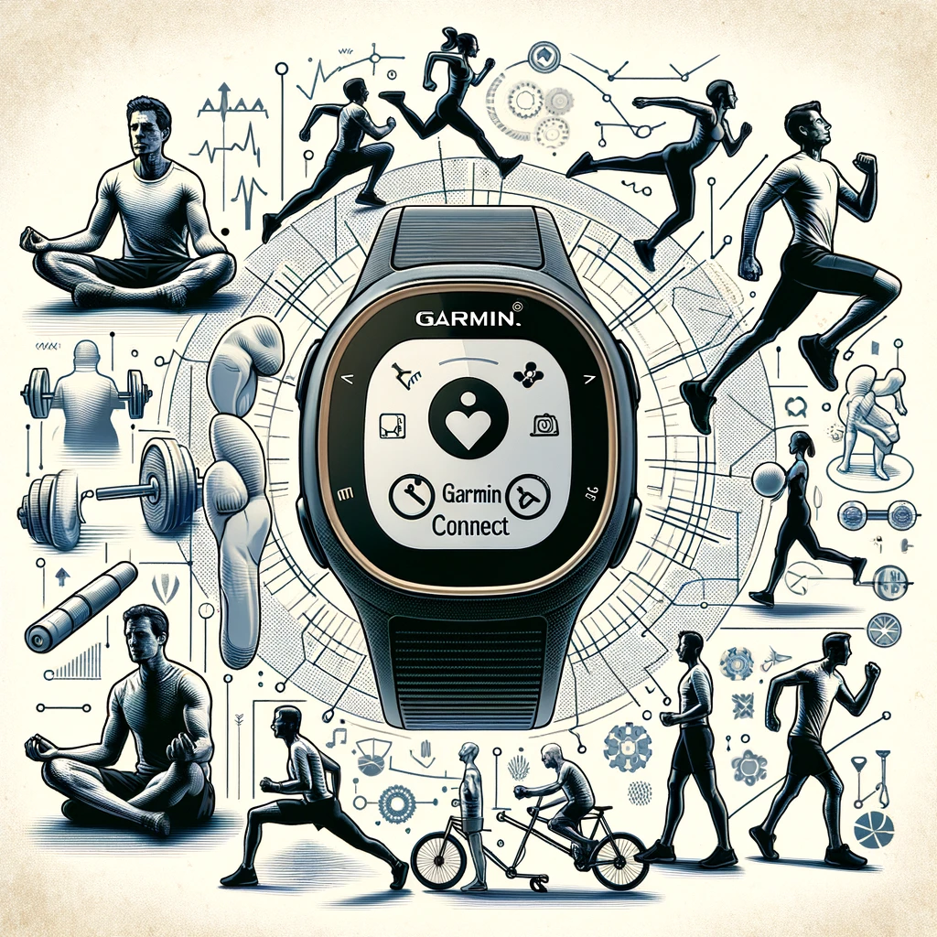
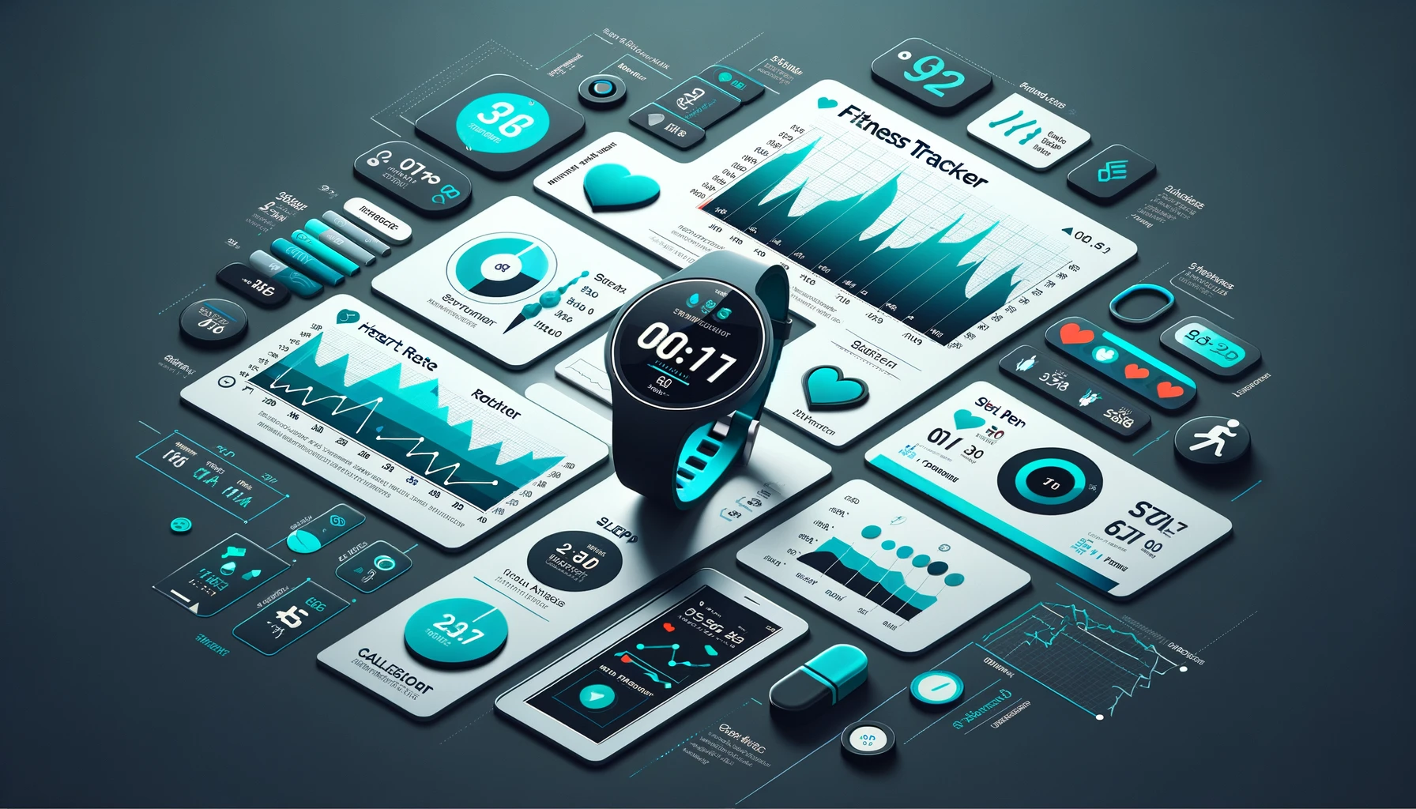
This is the story of a man and his one true love…
12.2%
of Americans use a smartwatch or a fitness tracker.
14.4%
World’s population in 2023 that used a smart wristband device
Source: Dataportal
… his fitness tracker.
Notes:
This is the story of a man and his one true love … his Garmin Connect. They go everywhere together, do everything together, he never leaves the house without the watch – in other words they're inseparable.
But he is not alone – according to research by Dataportal in 2023, 14.4% of the world’s population used a smart wristband device - that’s approximately 1.138 billion people.
It is an intimate thing to let a device record your every move and we decided to do away with any sentimentality and try and build a relational data engineering ecosystem around it. I’ll hand over to Sum to tell you more about our project.

Slide 3
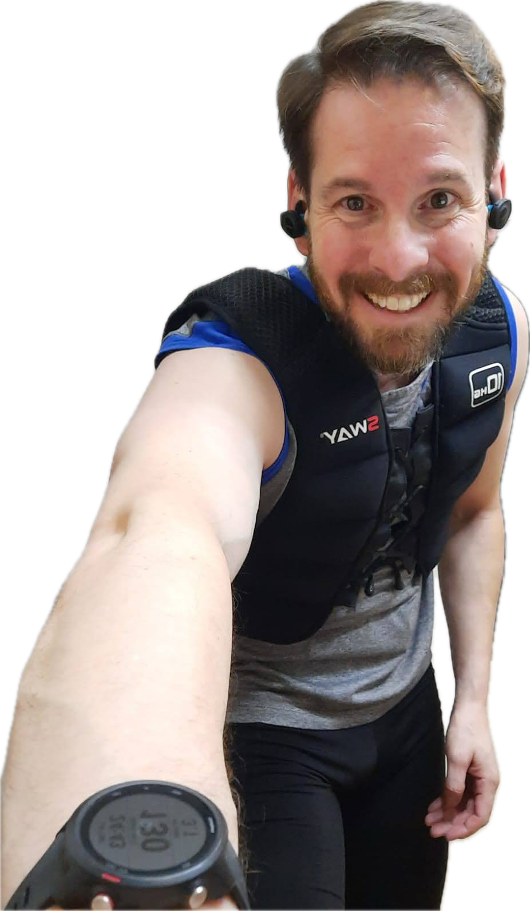
PROJECT OVERVIEW
ETHICAL CONSIDERATIONS
Develop a data engineering solution to analyse fitness patterns from Garmin wearable devices.
Anonymised data from a Garmin Connect watch, used with consent.
To structure rich datasets into a database, enabling potential visualisation and tracking of health and fitness.
Ethical Considerations
Commitment to Privacy and Ethics in Data
Informed Consent
Data provided voluntarily for non-commercial use.
Anonymity
Analysis ensuring individual privacy and confidentiality.
Ethical Use
Data handling aligns with high ethical values, prioritising user trust and integrity.
Building a Foundation for Data-Driven Fitness Analysis
Expandable Model
Ready to integrate additional data following ethical guidelines.
Research and Development
Aiding individuals and researchers in understanding physical activity.
Data Protection
Ongoing commitment to robust privacy and data security practices.
GOAL
DATA SOURCE
PURPOSE
FUTURE OUTLOOK
PRIVACY FIRST
Strict adherence to privacy, with no personally identifiable information (PII) used.
Designed for expansion, adding more data under strict ethical standards.
SCALABILITY
Notes:
Sum - Basic motivation for the project and ethical considerations
Our project aims to develop a comprehensive data engineering solution to analyse exercise and fitness patterns from Garmin wearable devices. By using data from an individual’s Garmin watch, we aim to transform this rich dataset into a structured database.Through additional visualisation efforts by application or web developers, individuals can track and enhance their health and fitness strategies.
We believe that well-structured and accessible data can unlock insights into exercise behaviours, aiding individuals and researchers in making informed decisions about physical activity.We are committed to maintaining the highest standards of privacy and ethics. The data used has been provided with informed consent, strictly for non-commercial purposes. All analysis ensures individuals’ anonymity, with no personally identifiable information (PII) being collected, stored, or analysed.The project design facilitates adding data from other individuals under similar ethical guidelines. This enriches our understanding of fitness patterns while upholding our commitment to privacy and data protection.With a commitment to privacy and ethical data use, our project serves as a foundation for scalable data-driven analysis in personal fitness.

Slide 4
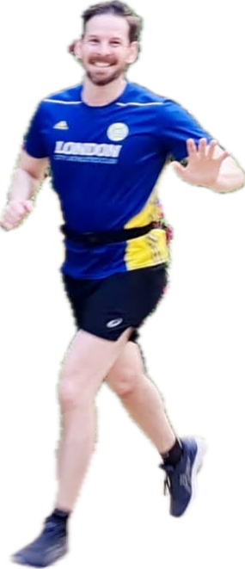
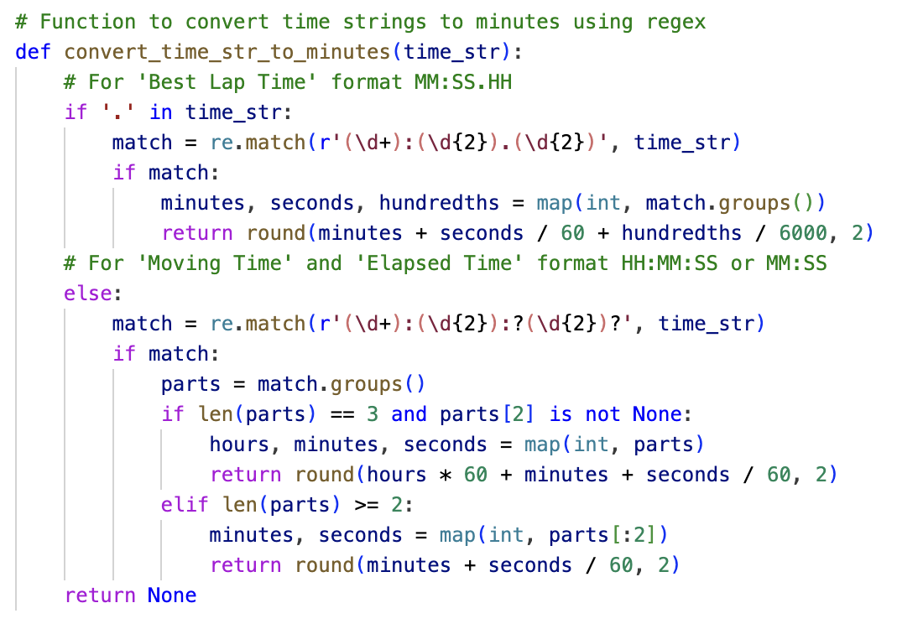
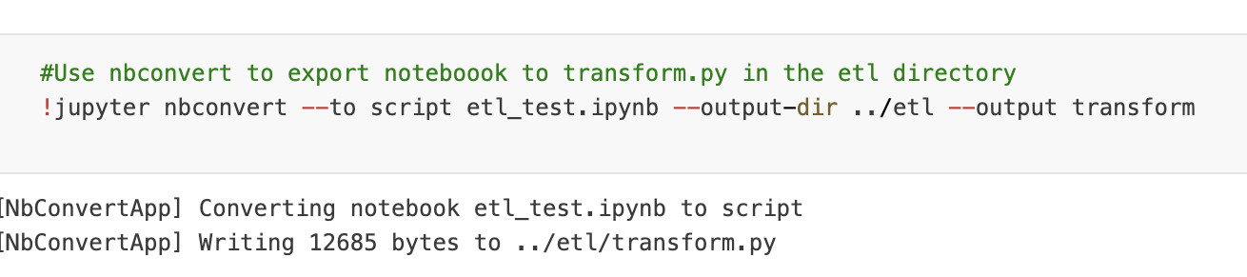
ETL PROCESS
LOADING
TRANSFORMATION
activities.csv
Contains basic details about each activity, such as activity ID, activity type ID, date, and title.
activity_types.csv
Provides a reference table for activity types, with unique activity type IDs and corresponding names.
performance_metrics.csv
Stores specific performance metrics for deeper analysis, including distance, calories burned, time, heart rate, and pace.
lap_metrics.csv
Captures lap-specific metrics such as lap time, number of laps, total distance, and moving/elapsed time.
elevation_metrics.csv
Records elevation-related metrics, including total ascent, total descent, and minimum/maximum elevation.
Data type conversions
Convert date and time strings to datetime objects.
Cleaning missing or invalid values
Remove rows with missing or invalid data.
Feature engineering
Calculate additional metrics such as average pace and lap distance.
Data filtering
Retain rows for specific activity types (e.g., Running and Swimming).
Concatenation of text columns for composite keys
Combine Activity ID and Activity Type ID to create unique metric IDs.
Resetting DataFrame indices
Reset DataFrame indices to ensure consistency and avoid index-related errors.
USE OF NBCONVERT
Notes:
Nida – Describe raw data and transformation process
The raw data included 413 entries from July 2020 till January 2024, across 42 different parameters (some of which were null) – since the individual granted us access to their data, we were able to start with a single large csv file. The raw data contained a wide range of information related to activity tracking sessions, such as activity type, date, title, performance metrics, lap metrics, and elevation metrics.
The transformation process was quite involved – mostly because the metrics were all stored as strings despite being distance or time measures. The sample code shown is a function we used to extract the relevant values using regex and to then convert the datetime values to minutes. This was then used for feature engineering to create metrics such as average pace and lap distance. The transformation process also involved removing null values and outliers where the watch had mistakenly recorded an instance of movement as ‘exercise’. We also generated alphanumeric Activity Type IDs and normalised the tables where relevant.
Ultimately 5 different csv files were generated from the raw data. The details of what these files contained is on the screen and our documentation talks about the motivation behind these decisions.
I’d also like to highlight the use of nbconvert The initial etl process was done in a jupyter notebook and we then used a data engineering library called nbconvert to automatically convert the jupyter notebooks into streamlined Python.py files.
The library made the transition from testing the code to converting it to a production calibre file very efficient and we believe it would be a key asset in the scalability of our project.
I’ll hand over to Aysha now to tell you more about our database design.

Slide 5
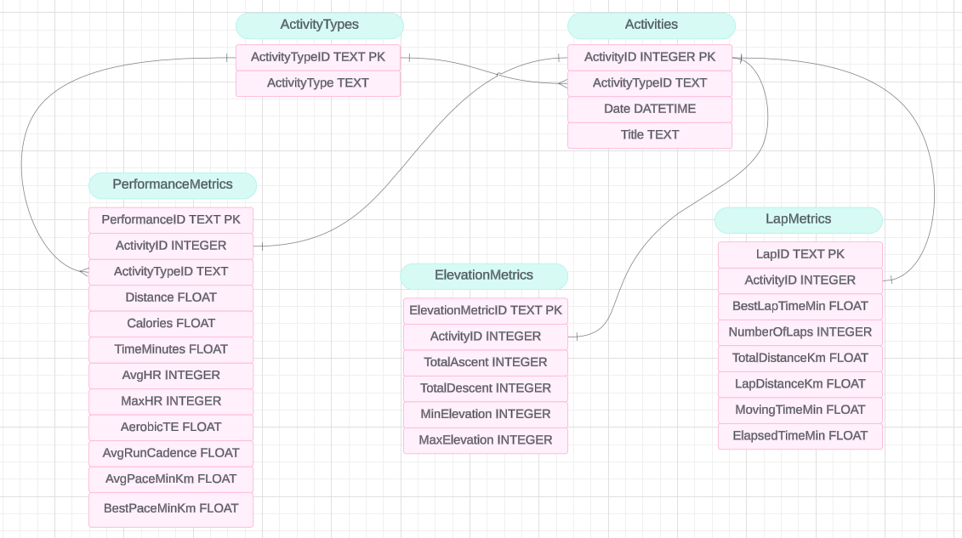
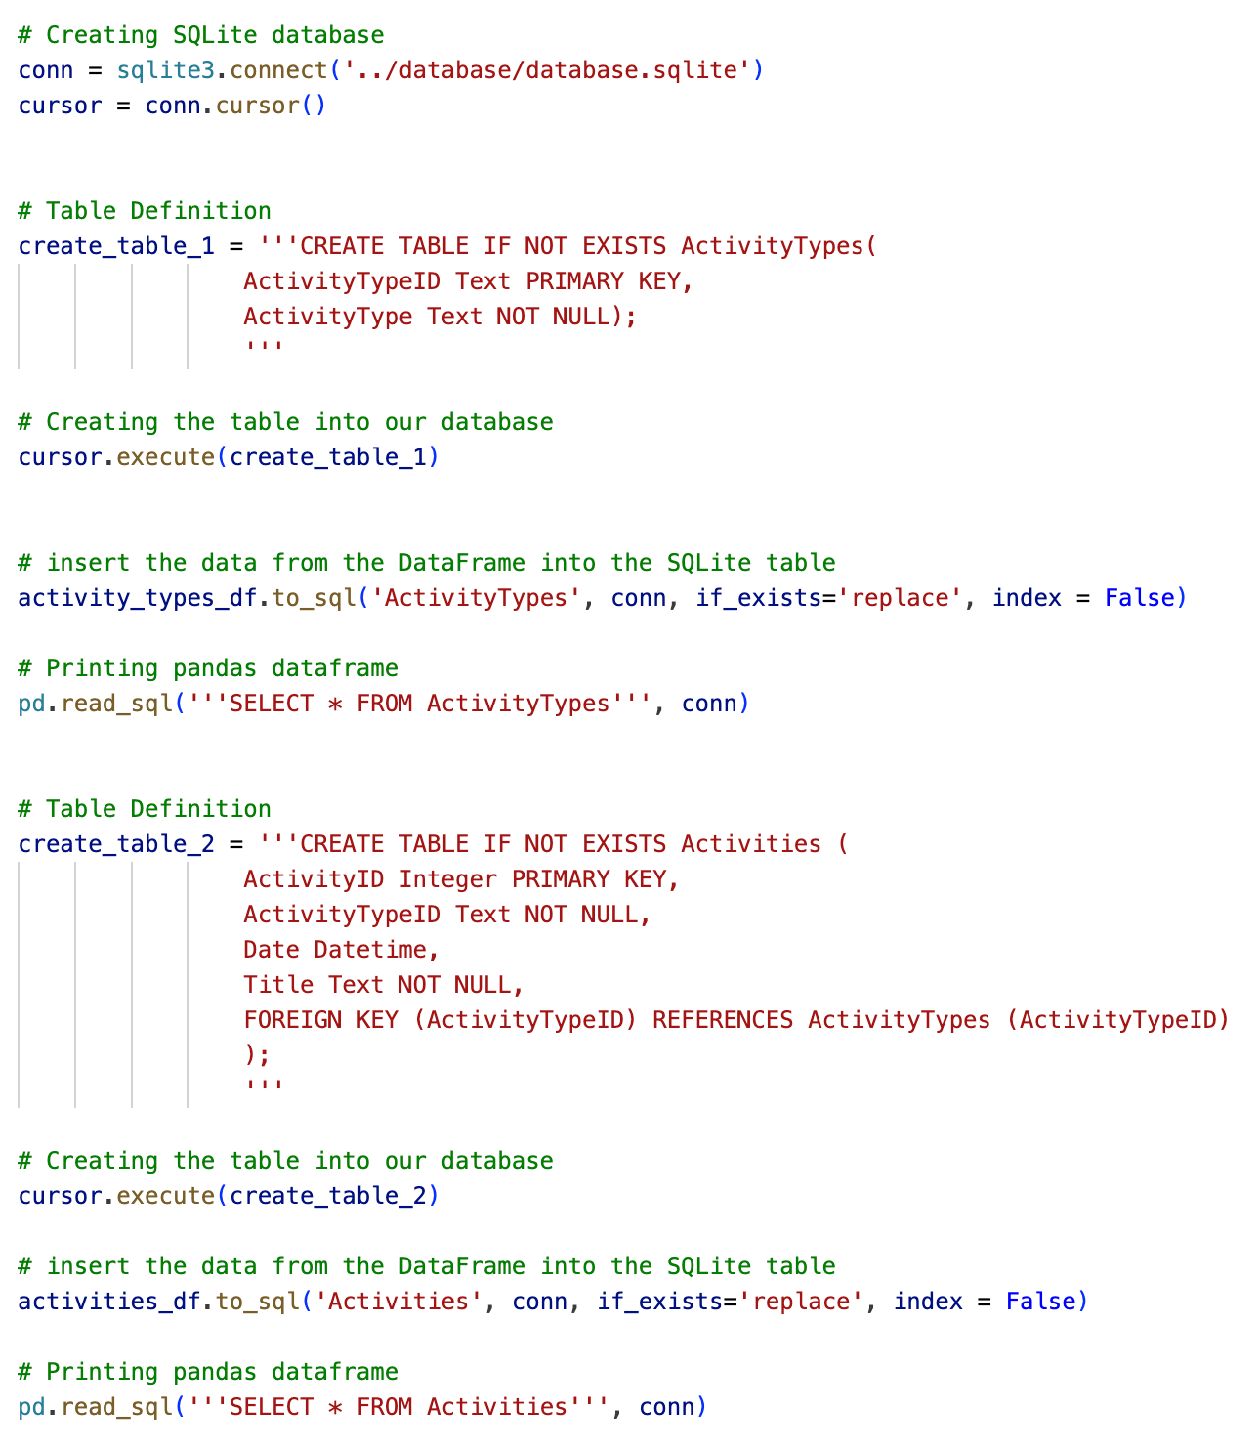
DATABASE DESIGN
ERD
SAMPLE CODE
DATABASE INTEGRITY CONSTRAINTS
Primary Keys
Each table has a primary key constraint to ensure uniqueness and identify each record uniquely.
Foreign Keys
Foreign key constraints establish relationships between tables, ensuring referential integrity and enforcing data consistency.
Unique Constraints
Certain attributes, such as ActivityTypeID and ActivityType in the ActivityTypes table, have unique constraints to prevent duplicate entries.
Notes:
Aysha – Talk through ERD and database creation
Justify use of SQLite
SQLite was chosen as the database management system due to its lightweight nature, ease of setup, and compatibility with a wide range of platforms. Overall, SQLite provides a robust relational database solution that meets the requirements of this project while offering scalability and performance for future expansion if needed.

Slide 6
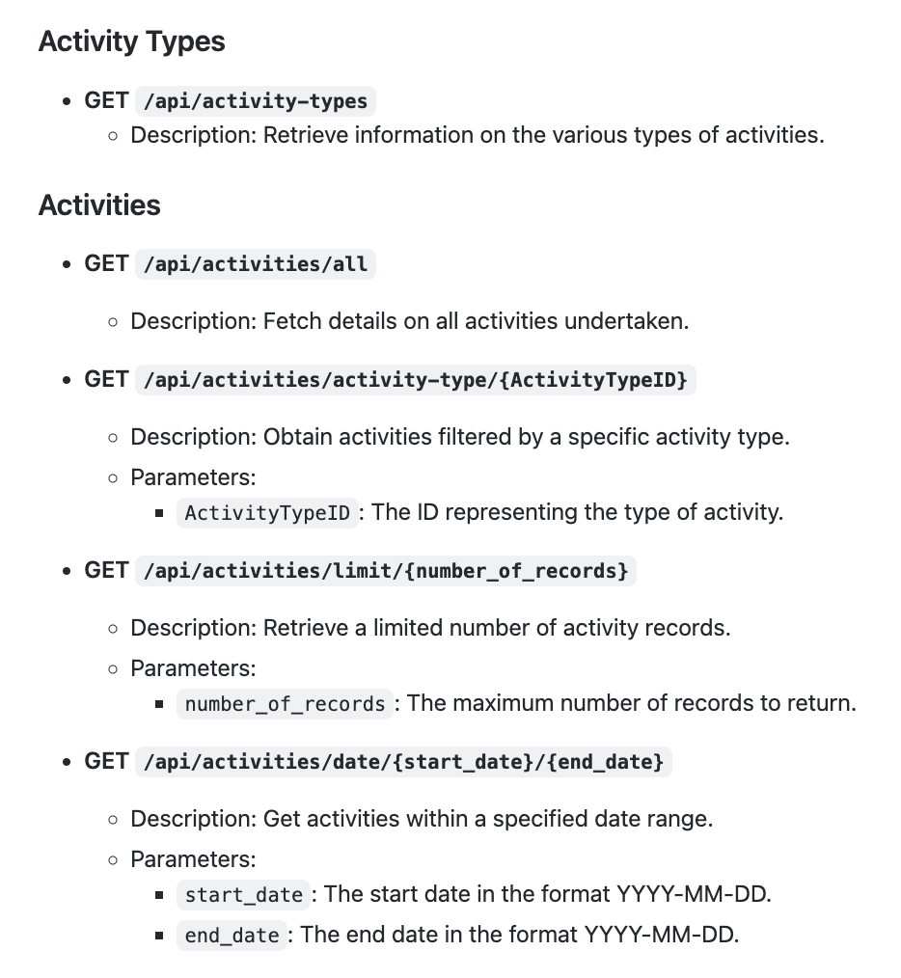
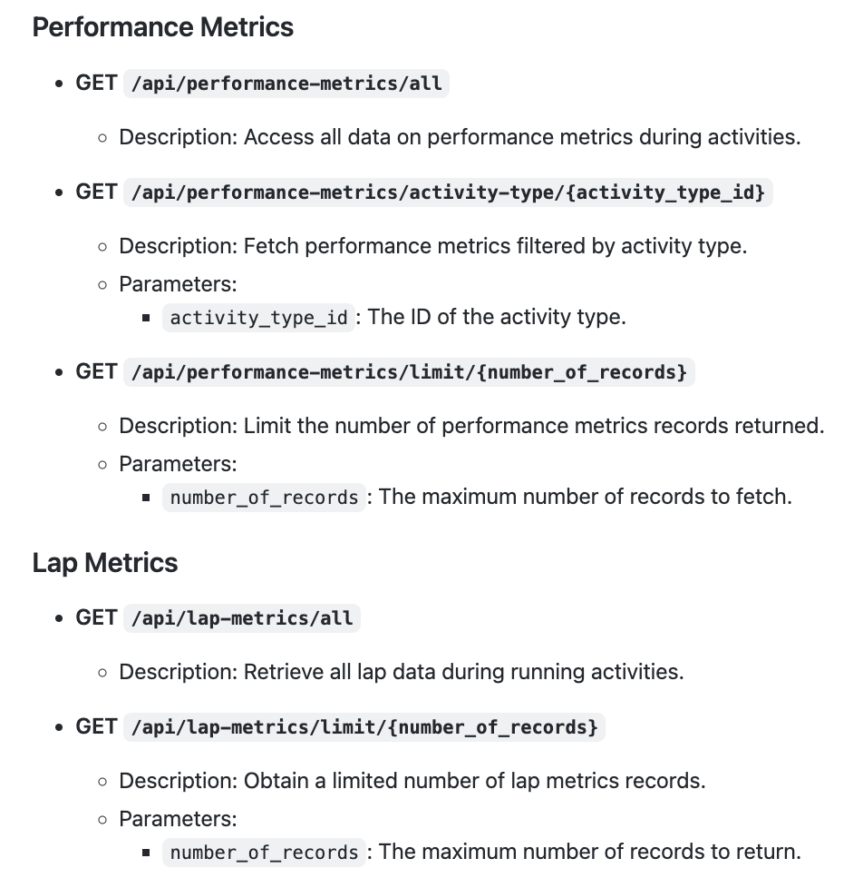
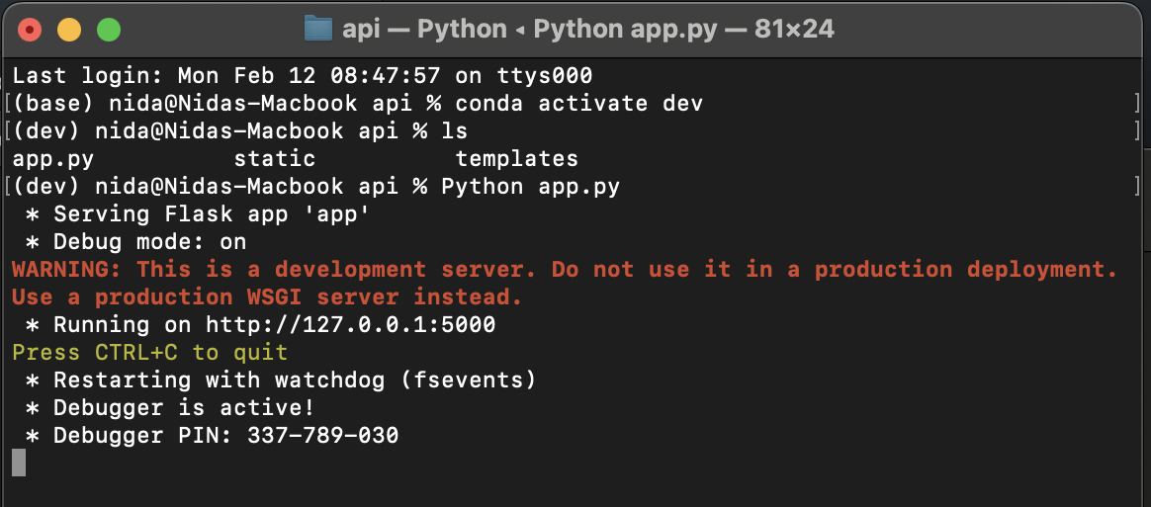
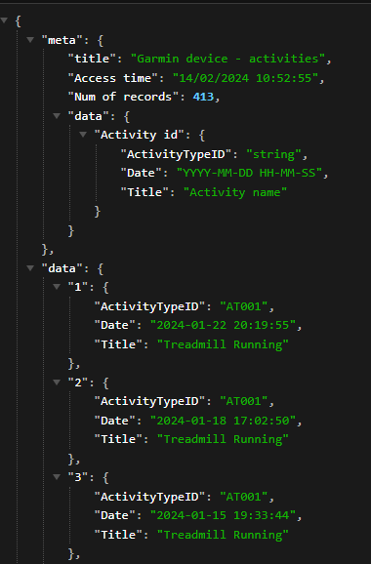
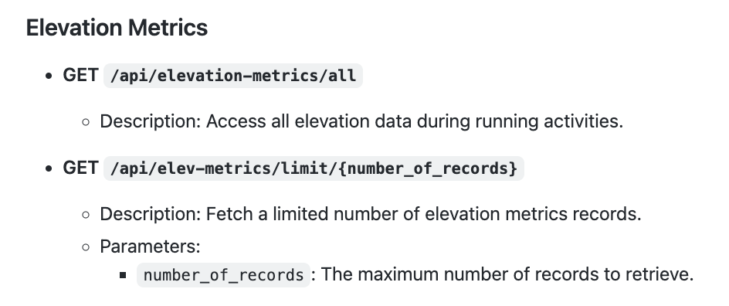
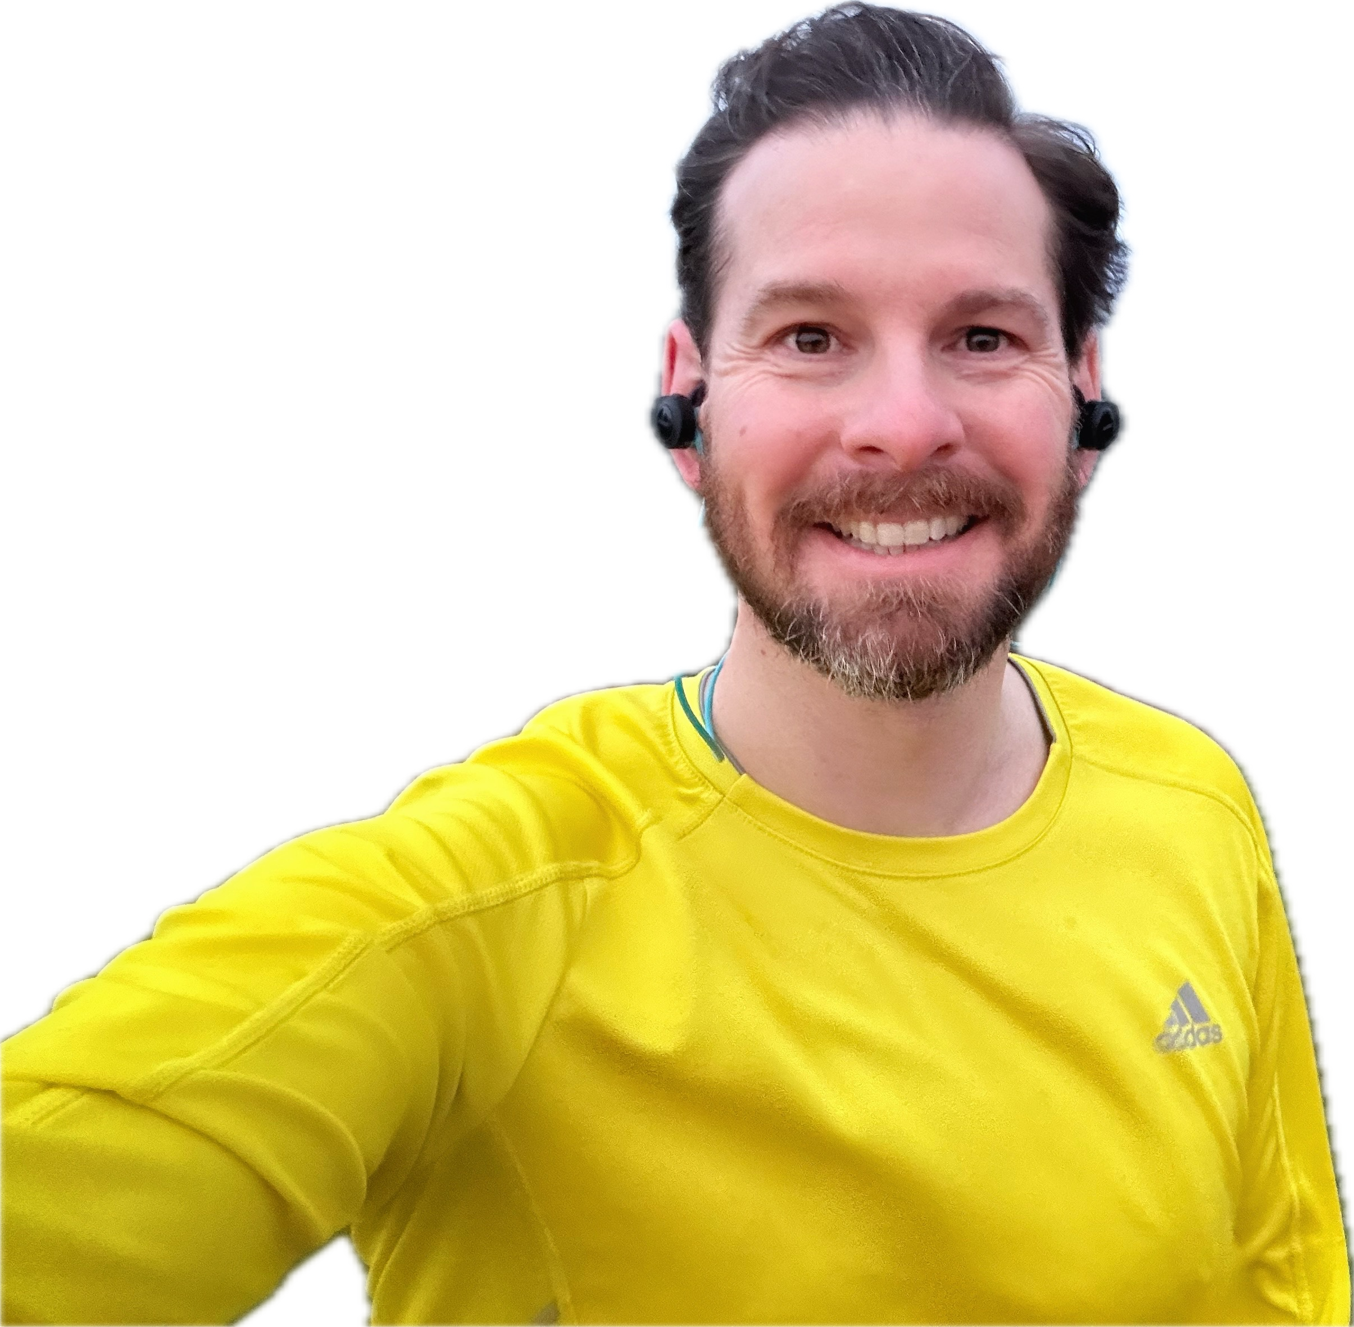
API ENDPOINTS
API
Activity Types
Performance Metrics
LAUNCHING FLASK APP
Activities
Lap Metrics
JSON RESPONSE STRUCTURE
Elevation Metrics
The JSON response from each endpoint includes both metadata and data sections.
Responses are structured to include metadata for informational purposes and a data array containing the requested records.
USAGE NOTES
Replace placeholders in curly braces {} with actual values.
The date format for endpoints involving dates is YYYY-MM-DD.
Notes:
Mohammad – Basic flask setup + showcase
To facilitate data accessibility, we leveraged a Flask web page interface. The entire process is orchestrated by a Python file named app.py. This file employs SQLAlchemy and Flask to extract tables from the SQLite database, as Aysha elaborated, and transforms them into JSON files. At the heart of our JSON structure lies a metadata dictionary situated in the bottom right corner, featuring essential details such as the database title and access timestamp. Following this metadata, there exists a data dictionary housing the table contents.
Accessing the Flask page is straightforward: execute the app.py file, which generates a URL for the local server. Simply copy and paste this URL into your web browser's address bar. Nida will be demonstrating the Flask page shortly.
In rendering the Flask page, we utilized Bootstrap and Flexbox to ensure an aesthetically pleasing and responsive layout. Furthermore, we introduced interactive elements to enhance user experience.
At the page's apex, you'll find two links: one directing to our GitHub repository and the other to the Garmin webpage, providing insights into the field names within our database tables. Nida, please navigate to the Garmin page.
Displayed on the page are five distinct sets of endpoints, corresponding to the five data tables outlined by Aysha. Each set offers two types of endpoints: Basic, which returns all data within the requested table, and Additional, enabling data filtration through various parameters. The Basic endpoints serve dual purposes: they can be appended to the URL for automated data extraction, as Nida will illustrate, or conveniently accessed via hyperlinks on the Flask page. As mentioned earlier, the JSON file encompasses both metadata and stored data. For the Additional endpoints, users can either append them to the URL, as demonstrated by Nida, or utilize the interactive features for data display. We've incorporated a pop-up table specifically showcasing the Activity Type ID, a common foreign key among the tables. Nida, could you please demonstrate the interactive elements for accessing data using the ActivityTypeID, retrieving the last five records, and filtering data within specified date ranges? In conclusion, we have presented our methodology for data access and exploration. Thank you all for your attention.

Slide 7


And they all exercised …
… happily ever after.
Notes:
QR to repo + Any questions

